Slide 1
Final submission of Credit Exploratory Analysis Assignment:-
Submitted by:- Sampatharao Lokesh
Date:- 28/04/2022

Slide 2

Basic understanding
If the applicant is likely to repay the loan, then not approving the loan results in a loss of business to the company
If the applicant is not likely to repay the loan, i.e. he/she is likely to default, then approving the loan may lead to a financial loss for the company.
Our role is to get the analysis about loss of interest like what are the factors important for recognizing genuine customer loss of principle
Recognizing fake customers trends like who are defaulting the loans more

Slide 3
Data provided for Analysis
There are 2 datasets which was provided and they are:-
Application data
Previous application data
Another dataset was of columns description for understanding each column

Slide 4
Prerequisites
Python
Python libraries:-
Numpy
Pandas
Matplotlib
Seaborn
Intertools
Warnings

Slide 5
Data understanding
Application_data.csv [inp1_apl]
Number of Columns: 122
Number of rows: 307511
Data types:- integer , float , string
Float : 65 , Integer:41 , Object:16
Previous_application_data.csv[inp2_pr]
Number of columns : 37
Number of rows: 1670214
Data type:- integer , float , strings
Float:15 , Integer:06, Object: 16

Slide 6
Data cleaning and Manipulation
How did we do that ?
Finding missing values
Filtering unwanted columns
Sorting the data
Fixing the datatype

Slide 7
Data cleaning and Manipulation
To remove or filter unwanted columns
First, I found out the missing value percentage (missing_value = inp1_apl.isnull(). sum() * 100 / len(inp1_apl)
By this code found out that there are 41 columns which consists more than 50% missing value
And then I removed those ir-relevant columns
And similarly after removing 50% data there were 10 columns which were more than 13% missing values

Slide 8
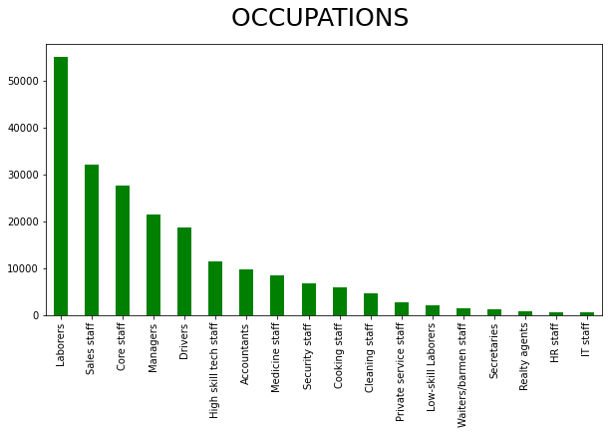
Imputing values
in that 10 columns there was a column “OCCUPATION_TYPE” , Which describes the user occupation was having 31% of missing Values.
First highest percentage is laborers
Second highest is sales staff but there is huge gap between them of 20000

Slide 9
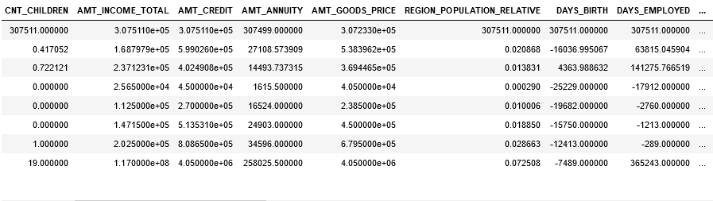
Standardizing Values
The statistics describe of application was like this [inp1_apl.describe( )]

Slide 10
Standardizing values
From previous slide we can see that there were few columns which had negative values so i converted them to negative(–ve) to positive(+ve)
Negative columns were :-
DAYS_BIRTH
DAYS_EMPLOYED
DAYS_REGISTRATION
DAYS_ID_PUBLISH
DAYS_LAST_PHONE_CHANGE

Slide 11
Standardizing Values
Very high value columns were :-
AMT_INCOME_TOTAL
AMT_CREDIT
AMT_GOODS_PRICE
Converting these numerical columns in categorical columns for better understanding.

Slide 12
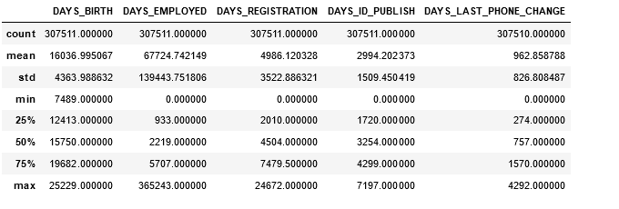
Standardizing the values
After converting negative columns to positive it looks like this:

Slide 13
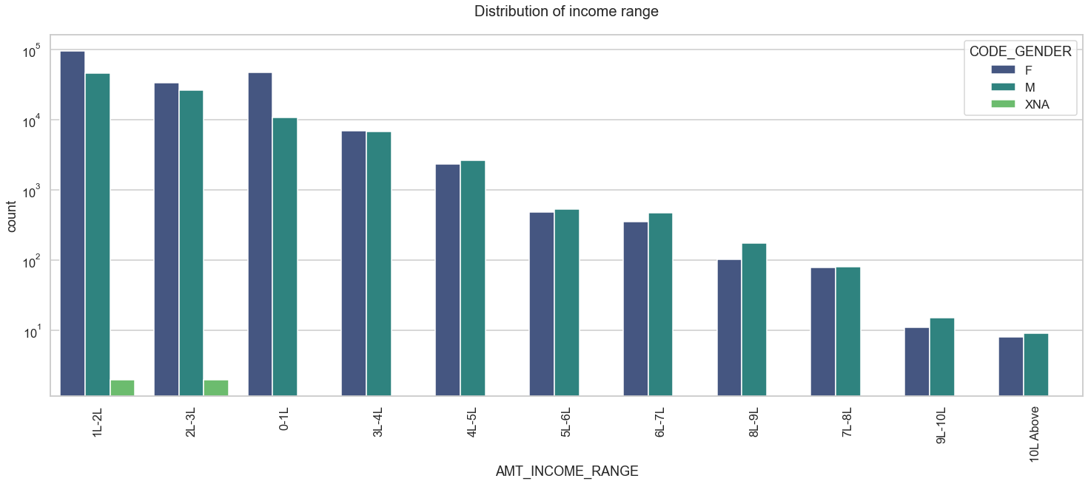
Plotting of income wise by gender
For target0 (all other)

Slide 14
Plotting of income wise by gender
Points to be calculated from previous slide graph
Female counts are higher than male.
Income range from 1L to 2L is having more number of credits.
This graph show that females are more than male in having credits for that range.
Very less count for income range 4L and above.

Slide 15
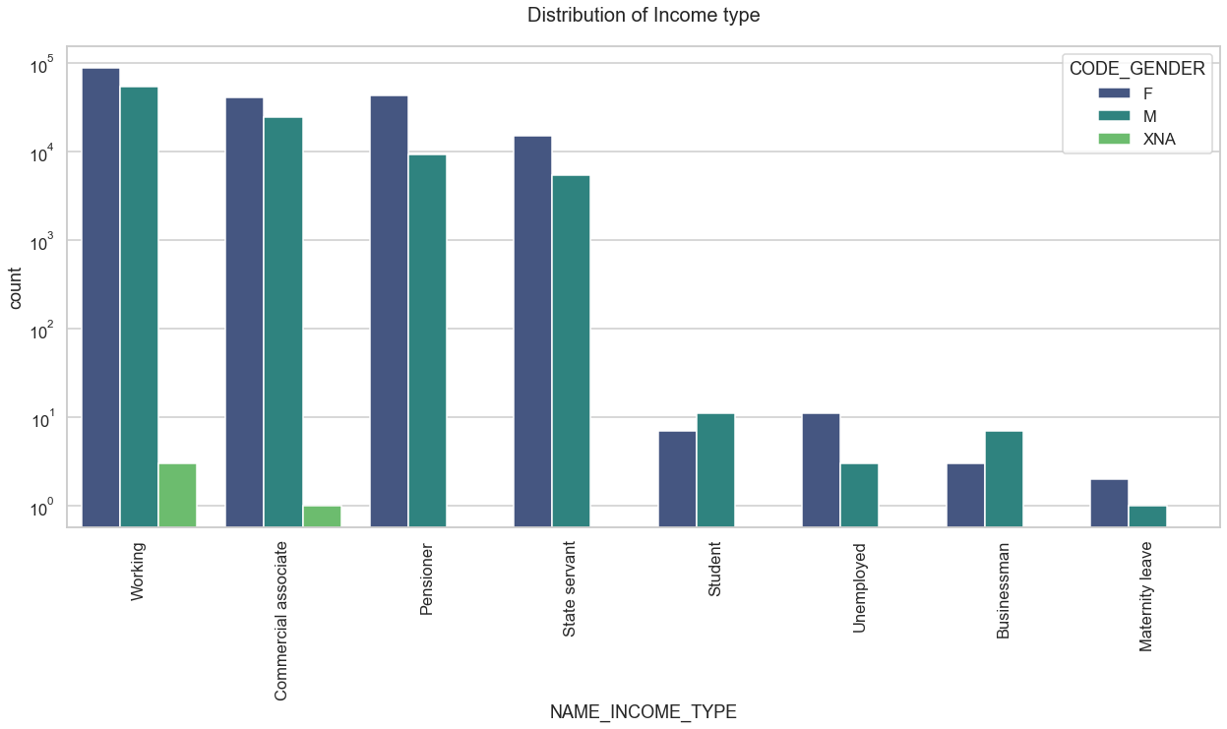
Distribution of Income type
For target0(all other)

Slide 16
Plotting of distribution of income type
For target0
Points to be conclude from previous slide graph
For income type ‘working’, ’commercial associate’, and ‘State Servant’ the number of credits are higher than others.
For this Females are having more number of credits than male.
Less number of credits for income type ‘student’ ,’pensioner’, ‘Businessman’ and ‘Maternity leave’.

Slide 17
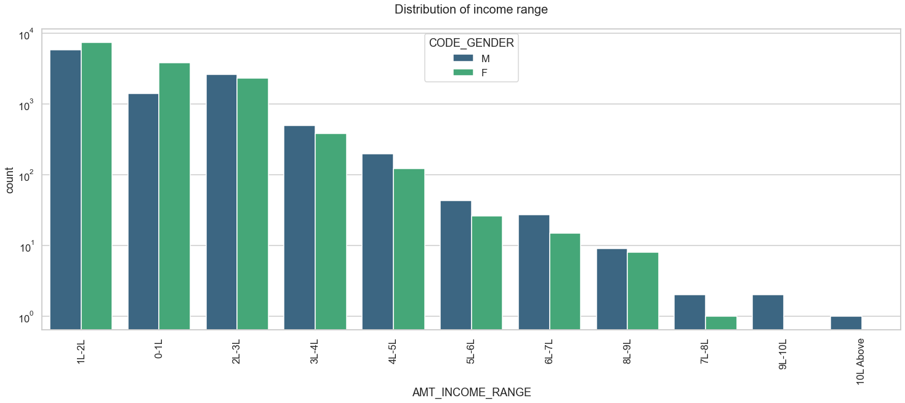
Distribution of income range
For target1(client with payment difficulties)

Slide 18
Plotting of distribution of income range
For target1
As you can see from the above graph
Females are more than men for income range between 1L-2L and 0L-1L but after 2L income range men are more than females

Slide 19
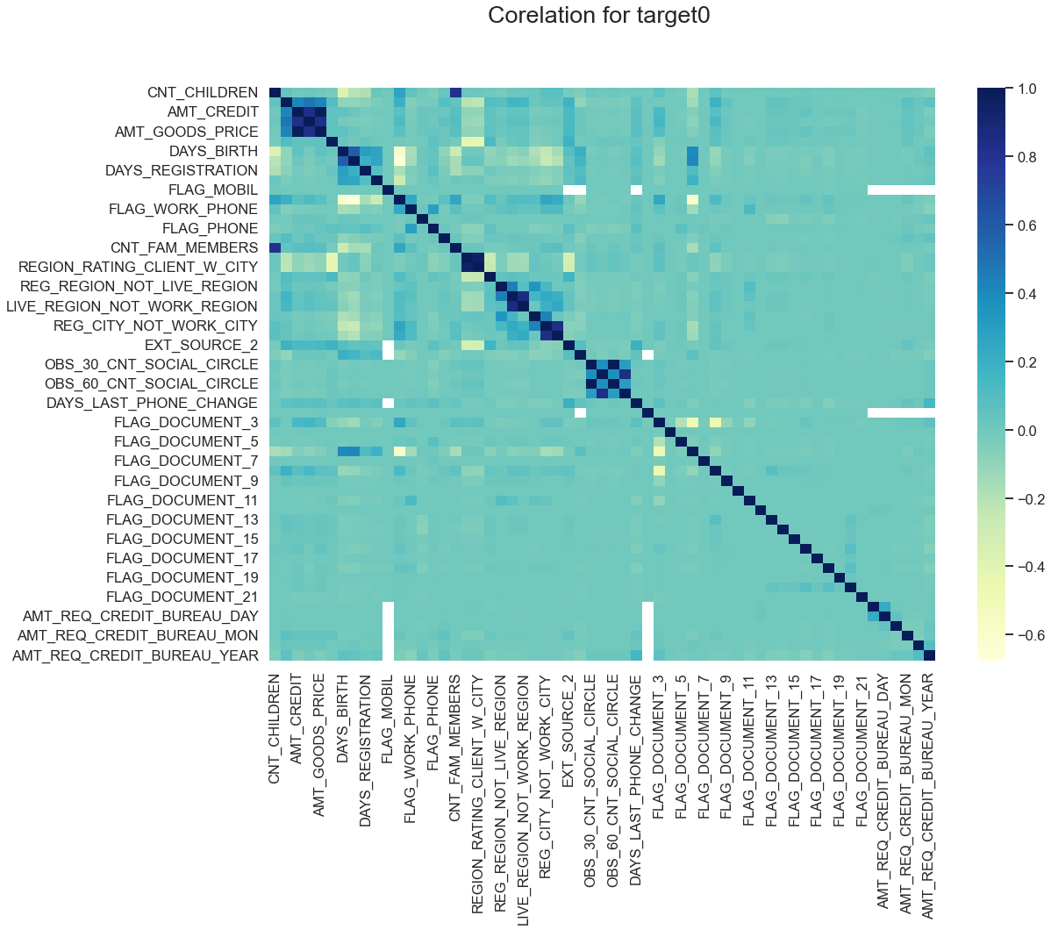
Correlation for target0 with heatmap
Co- relation for target 0

Slide 20
Correlation for target0 with heatmap
As we can see from above correlation heatmap, There are number of observation we can point out
Credit amount is inversely proportional to the date of birth, which means Credit amount is higher for low age and vice-versa.
Credit amount is inversely proportional to the number of children client have, means Credit amount is higher for less children count client have and vice-versa.
Income amount is inversely proportional to the number of children client have, means more income for less children client have and vice-versa.
less children client have in densely populated area.
Credit amount is higher to densely populated area.
The income is also higher in densely populated area.

Slide 21
Correlation for target1 with heatmap
Correlation for target 1

Slide 22
Correlation for target1 with heatmap
This heat map for Target 1 is also having quite a same observation just like Target 0. But for few points are different. They are listed below.
The client's permanent address does not match contact address are having less children and vice-versa
the client's permanent address does not match work address are having less children and vice-versa

Slide 23
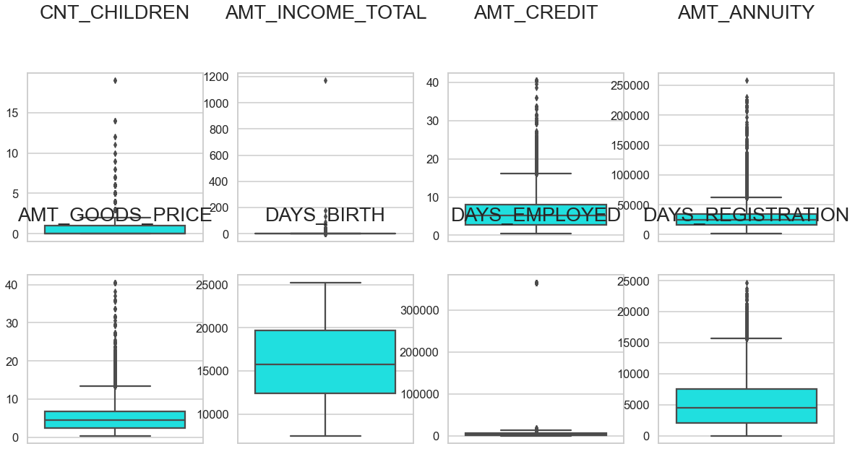
Outliers for APPLICATION_DATA

Slide 24
Outliers of APPLICATION_DATA
Finding outliers in
'AMT_ANNUITY' , 'AMT_APPLICATION' , 'AMT_CREDIT','AMT_GOODS_PRICE', 'SELLERPLACE_AREA','DAYS_DECISION','CNT_PAYMENT']
Summary It can be seen that in previous application data
AMT_ANNUITY, AMT_APPLICATION, AMT_CREDIT, AMT_GOODS_PRICE, SELLERPLACE_AREA consist max. number of outliers.
CNT_PAYMENT consist less outlier values.
DAYS_DECISION has little number of outliers indicating that these previous applications decisions

Slide 25
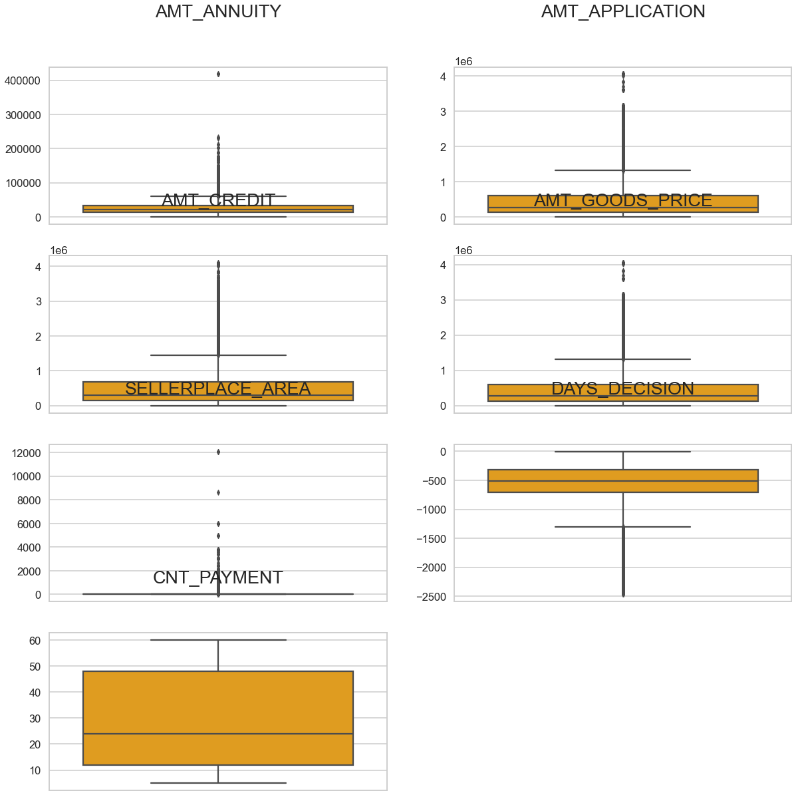
Outliers for PREVIOUS_APPLICATION_DATA

Slide 26
Outliers for PREVIOUS_APPLICATION_DATA
AMT_ANNUITY, AMT_APPLICATION, AMT_CREDIT, AMT_GOODS_PRICE, SELLERPLACE_AREA consist max. number of outliers.
CNT_PAYMENT consist less outlier values.
DAYS_DECISION has little number of outliers indicating that these previous applications decisions.

Slide 27
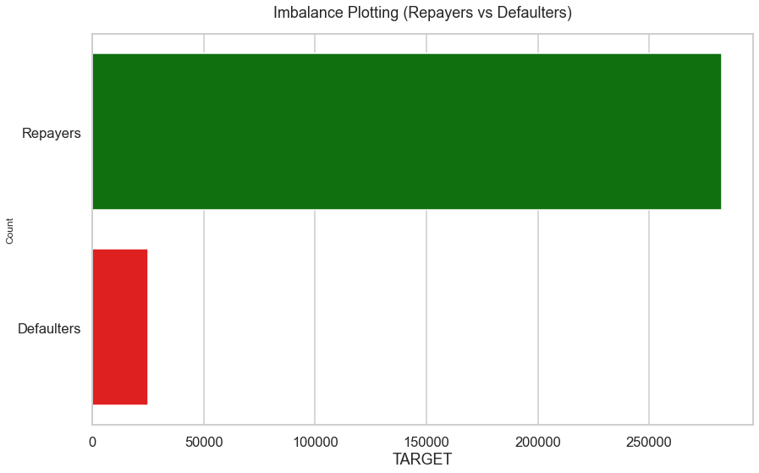
check for imbalance in data between repairers and defaulters

Slide 28
Imbalance data between repairers and defaulters
Repairer Percentage is 91.93%
Defaulter Percentage is 8.07%
Imbalance Ratio with respect to
Repairer and Defaulter is given: 11.39/1 (approx)

Slide 29


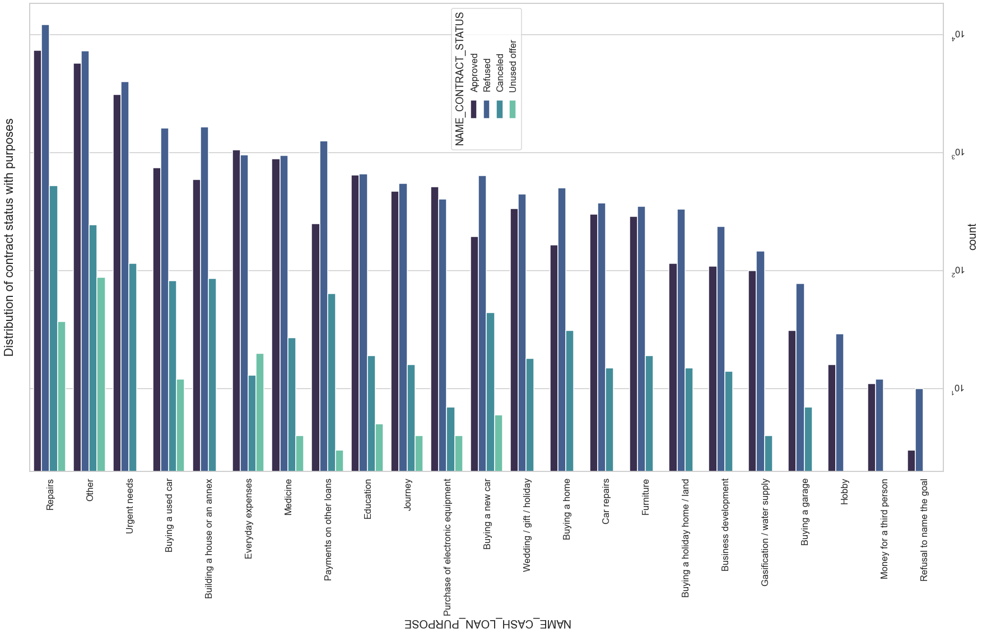


Univariate Analysis
Univariate analysis of distribution of contract status with purposes

Slide 30
Univariate Analysis
Previous slide graph is not clear because of the size of graph not fitting in slides but we can see from jupyter notebook that
Most rejection of loans came from purpose 'repairs'.
For education purposes we have equal number of approves and rejection
Paying other loans and buying a new car is having significant higher rejection than approves.

Slide 31

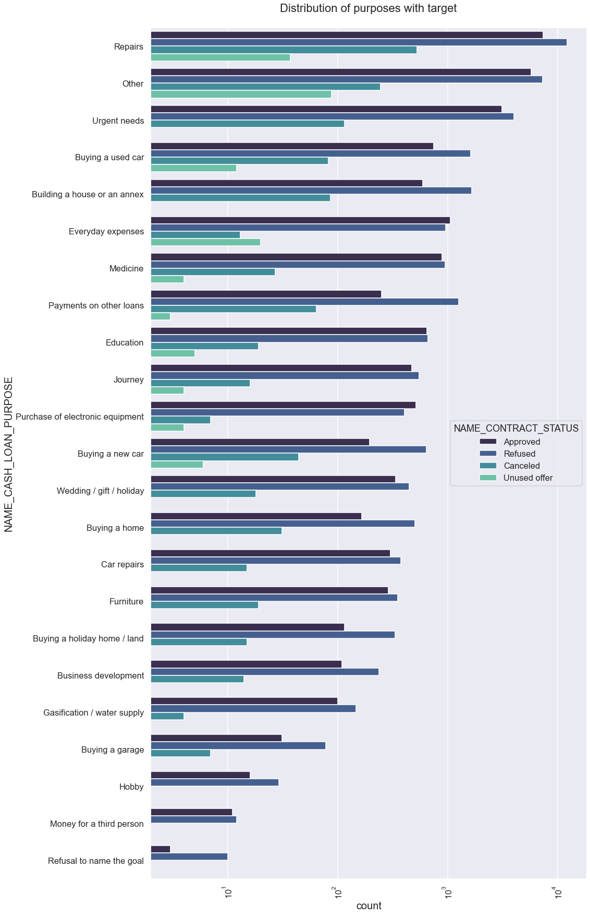
Univariate Analysis
Univariate analysis of distribution of contract status with target

Slide 32
Univariate Analysis
Previous slide graph is not clear because of the size of graph not fitting in slides but we can see from jupyter notebook that
Loan purposes with 'Repairs' are facing more difficulties in payment on time.
There are few places where loan payment is significant higher than facing difficulties. They are 'Buying a garage', 'Business development' , 'Buying land' ,'Buying a new car' and 'Education' Hence we can focus on these purposes for which the client is having for minimal payment difficulties.

Slide 33
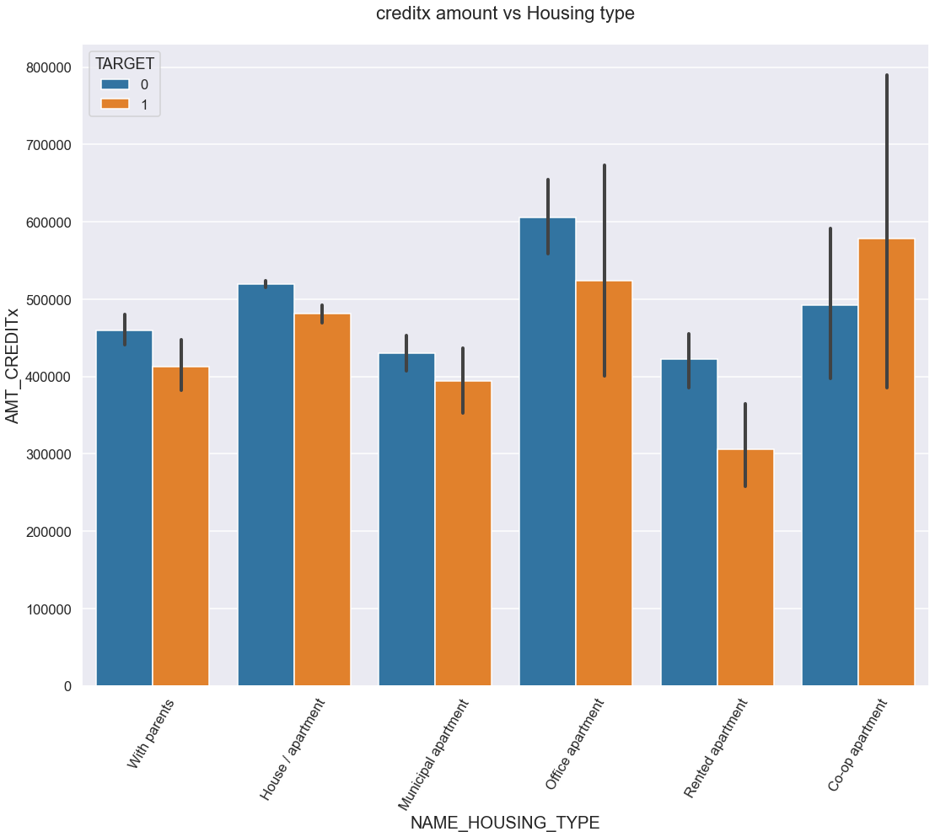
Bivariate Analysis
Box plotting for credit amount creditx vs housing type

Slide 34
Bivariate Analysis
Here for Housing type, office apartment is having higher credit of target 0 and co-op apartment is having higher credit of target 1.
So, we can conclude that bank should avoid giving loans to the housing type of co-op apartment as they are having difficulties in payment. Bank can focus mostly on housing type with parents or House\apartment or muncipal apartment for successful payments.

Slide 35
Conclusion
Banks should focus more on contract type ‘Student’ ,’pensioner’ and ‘Businessman’ with housing ‘type other than ‘Co-op apartment’ for successful payments.
Banks should focus less on income type ‘Working’ as they are having most number of unsuccessful payments.
Also with loan purpose ‘Repair’ is having higher number of unsuccessful payments on time.
Get as much as clients from housing type ‘With parents’ as they are having least number of unsuccessful payments.

